Slide 1

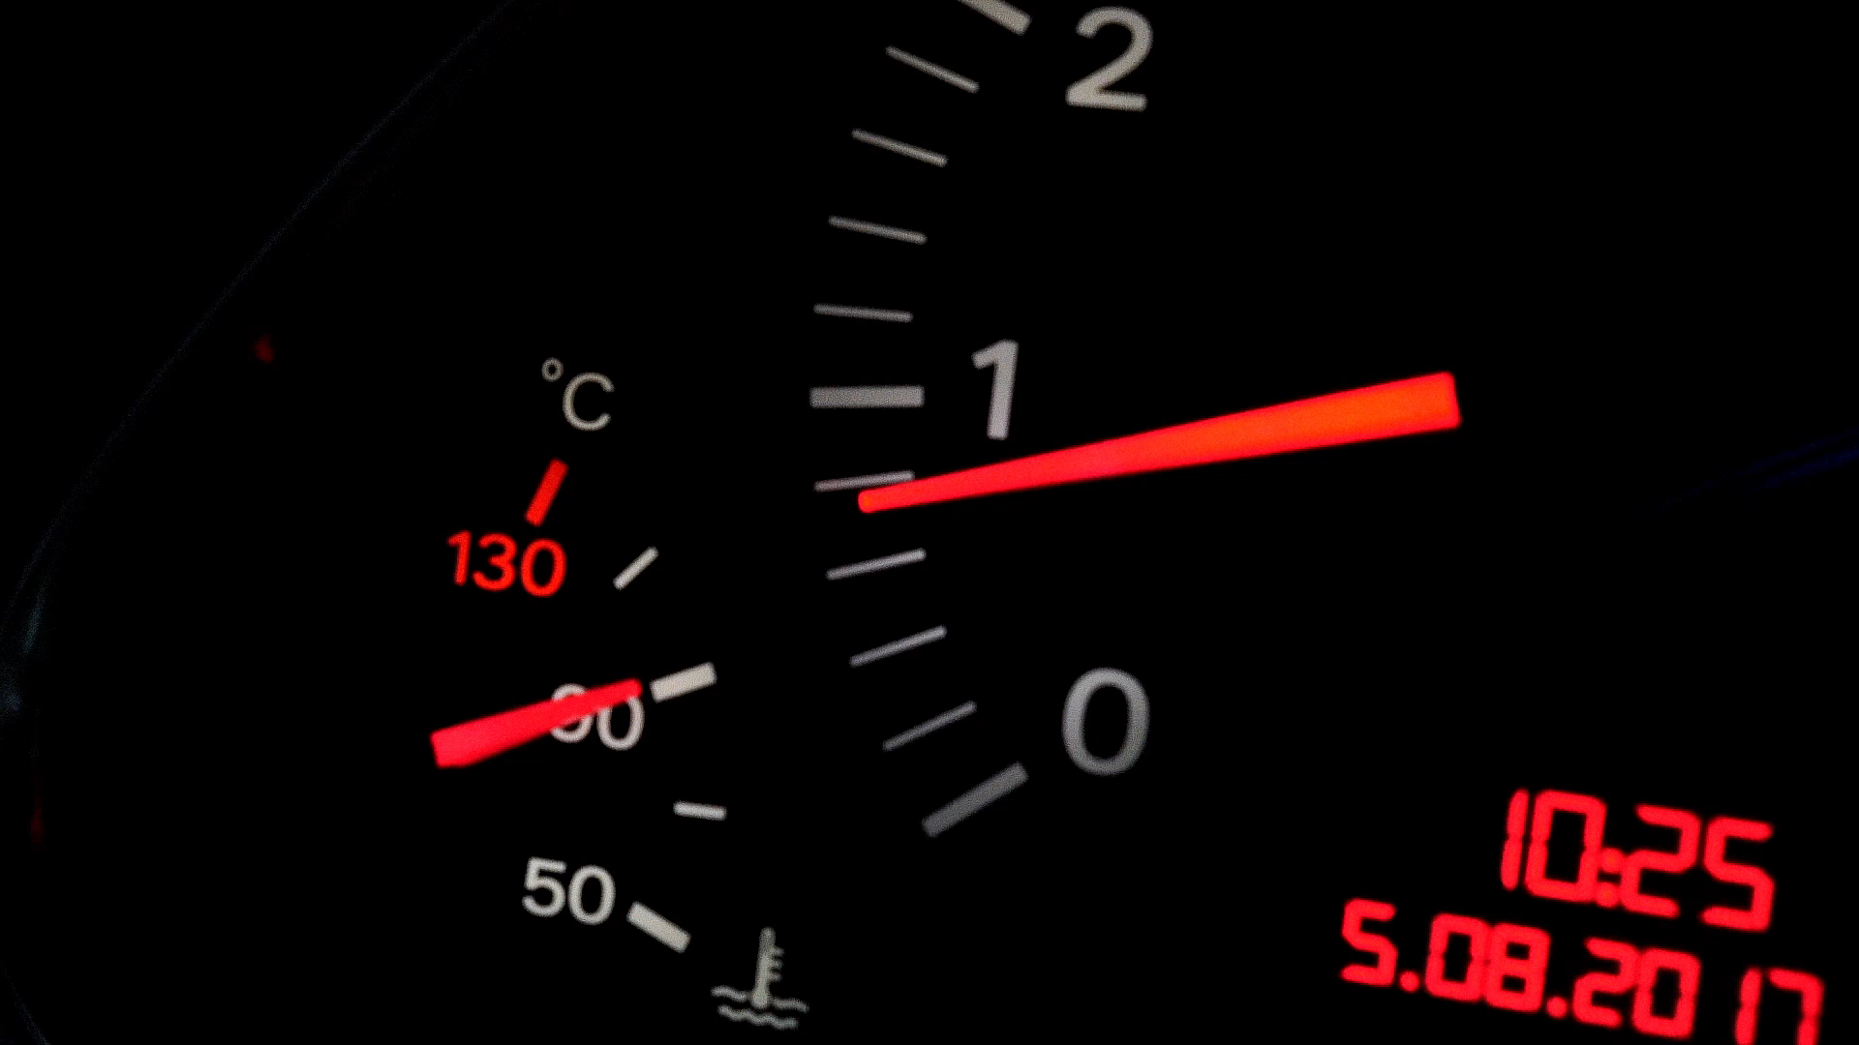

DRIVER DROWSINESS DETECTION SYSTEM
Department of Computer Science and Engineering
Under the supervision of :
Dr. Rajib Ghosh
Assistant Professor
NIT PATNA
Vineet Raj (2106019)
Aditya Kumar (2106011)
Rupesh (2106005)

Slide 2
Outline
Introduction
Problem Statement
Objective
Proposed Methodology
Dataset
Result
References

Slide 3
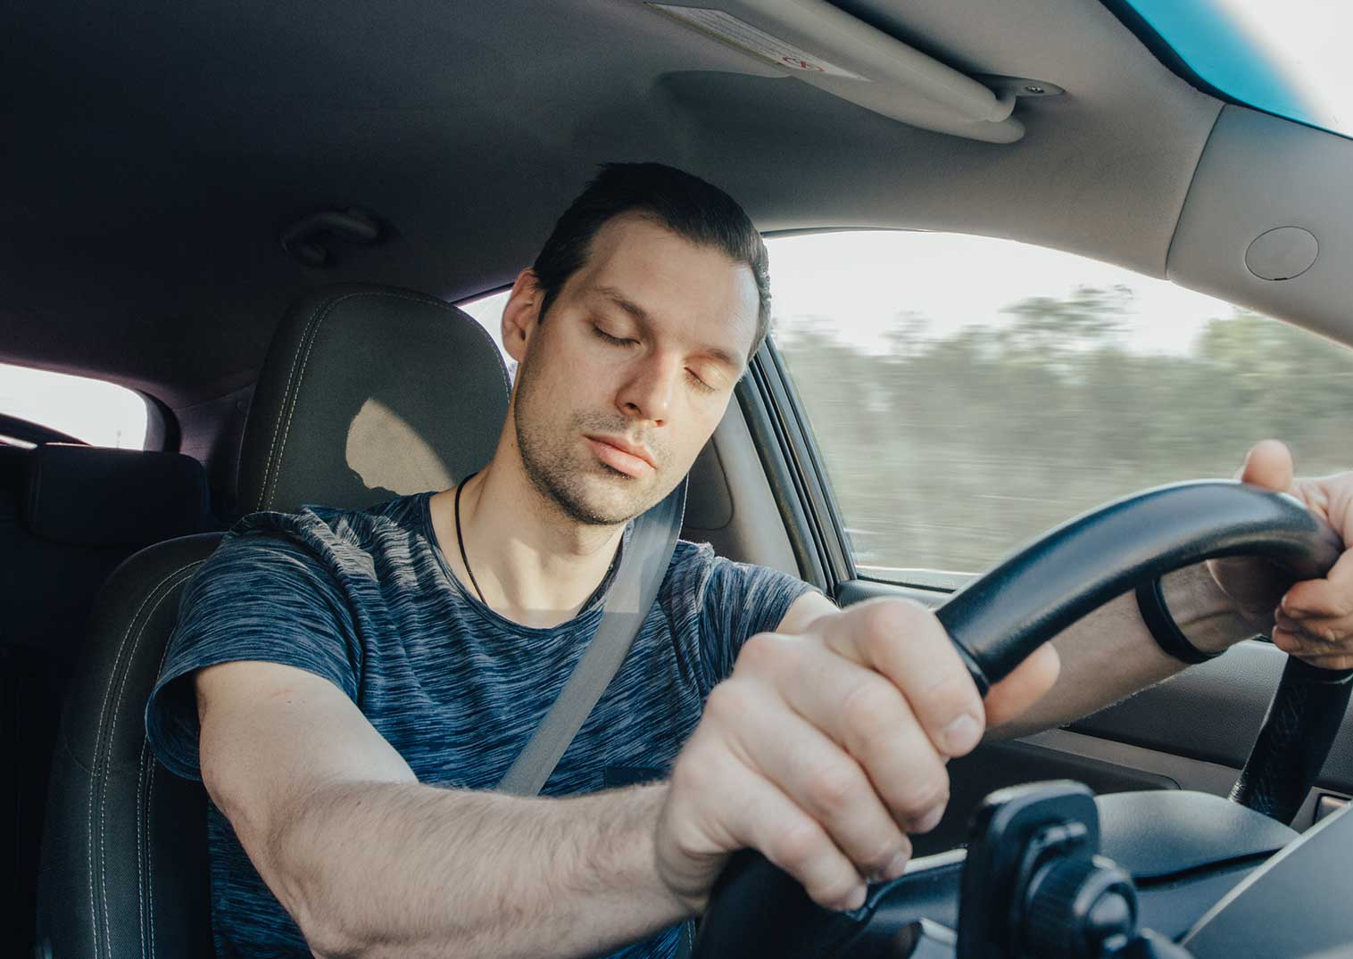
Introduction
Driver drowsiness refers to a state of decreased alertness and impaired performance caused by physical and mental fatigue. Factors such as lack of sleep, long driving hours, night driving, or monotonous road conditions can lead to drowsiness, reducing a driver’s ability to respond quickly to traffic events.
In today's fast-paced world, road safety has become a critical concern. One of the leading causes of road accidents is driver drowsiness. Fatigue-related crashes can be just as dangerous as those caused by drunk driving. Therefore, it is essential to understand the importance of detecting driver drowsiness in real-time, which can significantly reduce accidents, save lives, and enhance road safety.

Slide 4
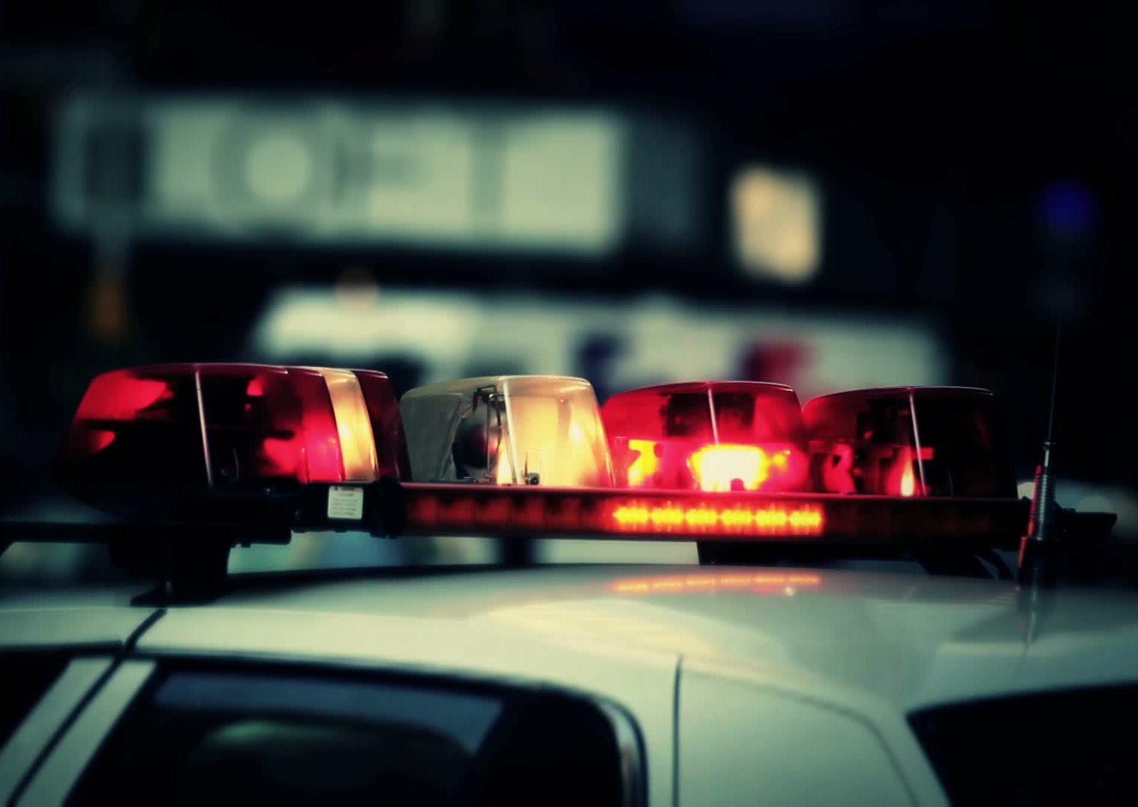
Problem Statement
Accidents caused due to drowsy driving are a major problem in the World.
The National Highway Traffic Safety Administration estimates that drowsy driving was responsible for 72,000 crashes, 44,000 injuries, and 800deaths in 2013[1].
Drowsiness detection technologies have attempted to prevent such incidents by predicting if a driver is falling asleep based on various inputs.

Slide 5
Objective
This project outlines the design and development of a system that focuses on driver’s drowsiness detection and prediction.
Monitoring the driver behaviour by observing the manoeuvre stability and performance.
Validate and measure the progress by using Specific algorithm.
Warning the drivers if the behaviour beyond the thresholds.
Here we will employ machine learning methods to classify the data of actual human behaviour during drowsiness.

Slide 6

Proposed Methodology

Slide 7
Flow Diagram
start:Load Data
Preprocess Data(resizing)
Train(70%)
Test(30%)
Split
Data Augmentation
Prediction
Evaluate Model
Train Model
Build CNN
Model

Slide 8
Method
The proposed model includes the following key components and steps:
Data Collection and Preprocessing
Load images from specified directories (archive/train).Detect faces in the images using Haar Cascade Classifier.Resize the detected faces to a uniform size (145x145 pixels).
Data Augmentation
Apply transformations such as zoom, horizontal flip, and rotation to enhance the dataset and prevent overfitting.
Model Building
Construct a CNN with multiple convolutional and pooling layers to extract features from the input images.

Slide 9
Method(contd)
Model Training
Train the model using the augmented data, utilizing categorical cross-entropy as the loss function and Adam optimizer.
Model Evaluation
Validate the model on a separate test dataset and visualize training/validation accuracy and loss.
Prediction
Implement a prediction function to classify input images into categories: yawn, no_yawn, Closed, and Open.Use the trained model to predict the state of the driver based on input images.

Slide 10
Dataset
Closed Files : 726
Open eyes : 726
Yawn : 726
No Yawn : 726

Slide 11
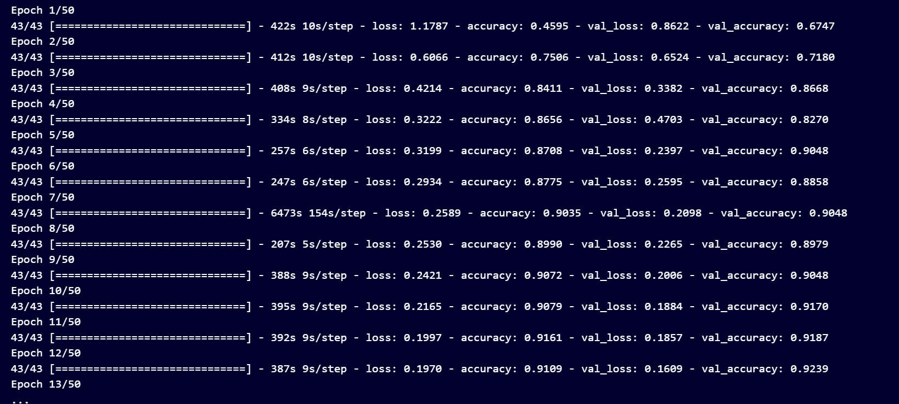
Result
Fig 1

Slide 12
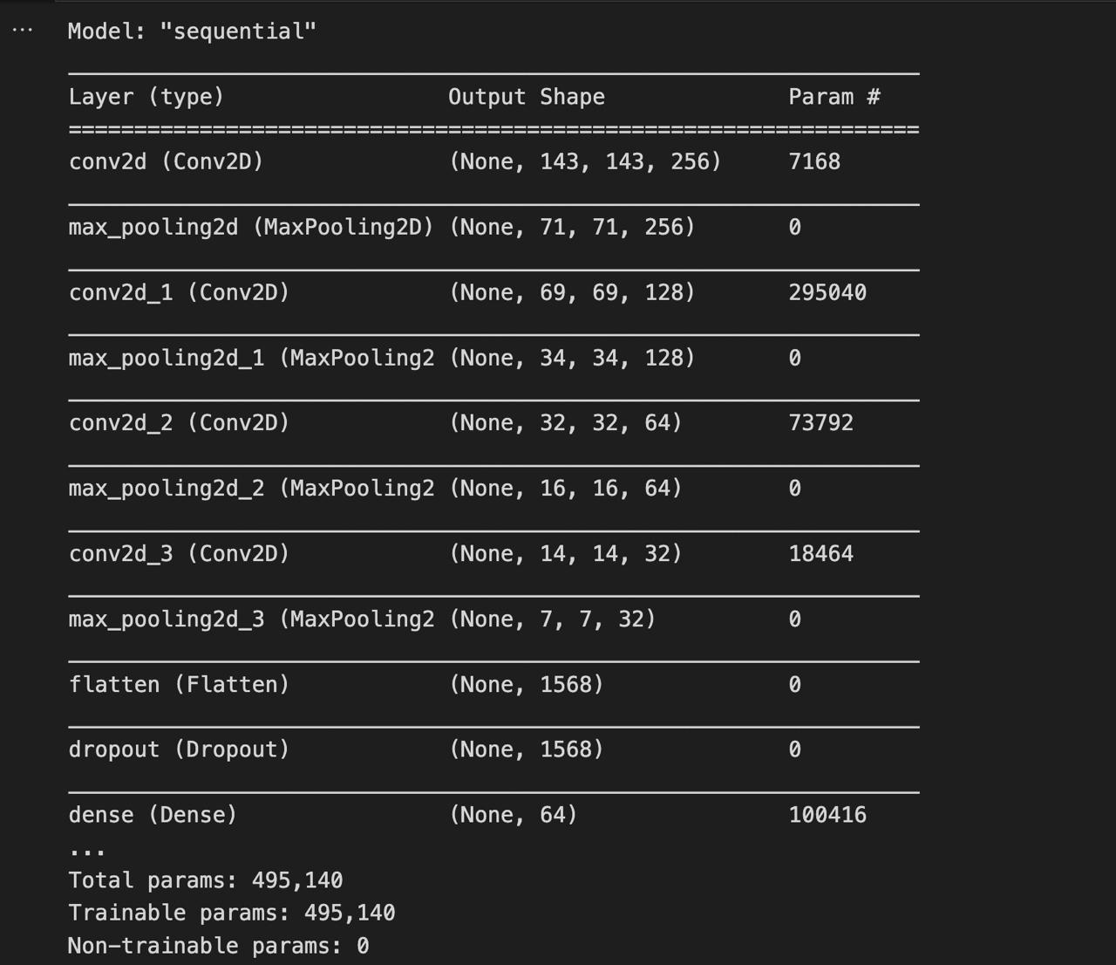
Result(contd)
Fig 2

Slide 13
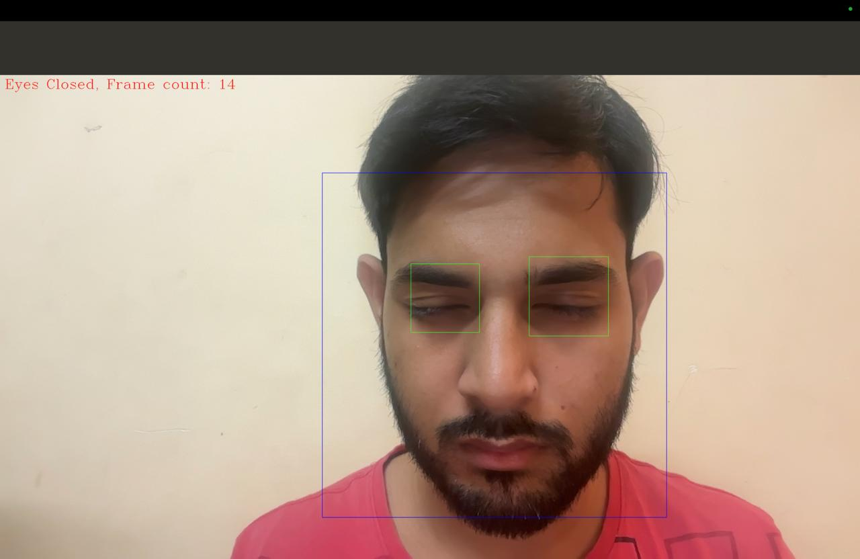
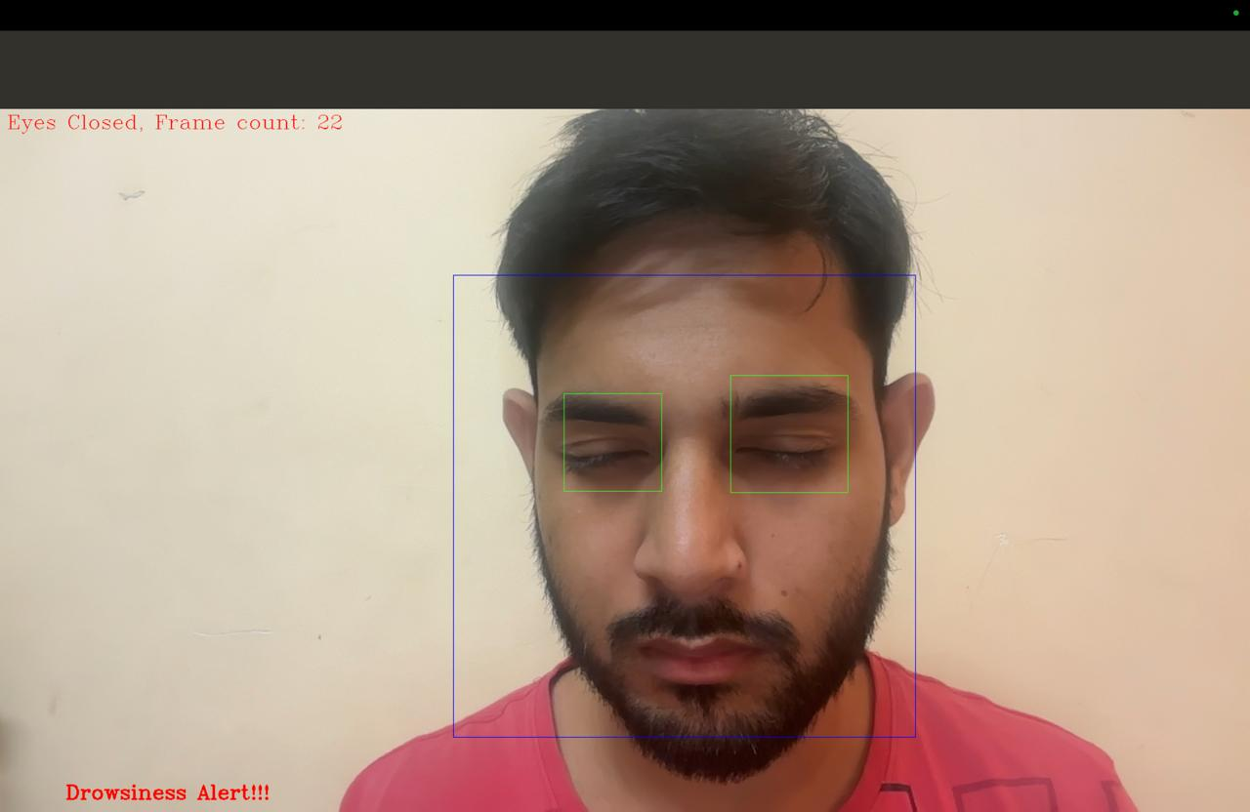
Result(contd)
Number of Frames : 20
Time taken : 5 sec
Frame Rate : 20/5 = 4fps
Alarm not beep
Alarm beep
Fig 3
Fig 4

Slide 14
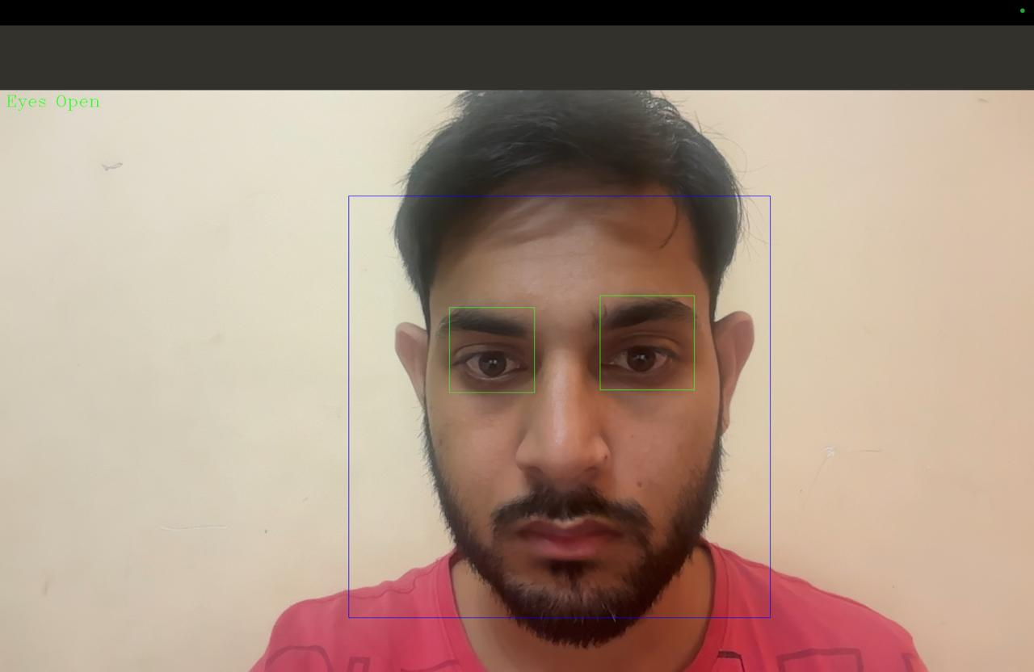
Result(contd)
Fig 5

Slide 15
References
Driver drowsiness detection with eyelid related parameters by SupportVector Machine
Hu Shuyan, Zheng GangtieSchool of Astronautics, Beijing University of Aeronautics and Astronautics, 37 Xueyuan Road, Haidian District, Beijing 100083, China

